Slide 1
CarChoice: Discover Your Ideal Four-Wheeler
Priyadarshini Chadalawada
Rohita Jahnavi Jala
Chanikya Boggarapu

Slide 2
Introduction
As international students from India living in the USA, we faced challenges navigating the unfamiliar vehicle market here. This experience led us to develop our **Vehicle Inventory System**—a platform designed to help users compare and explore 4-wheeler vehicles from both the USA and India.
Individuals like us, who may not be familiar with foreign car brands and models, this system offers an easy and accessible way to compare options across both markets, making the car-buying process simpler and more informed.

Slide 3
Understanding the problems
01
The system shall ensure that the car comparison features load without lag, providing a high-performance user experience.
02
The system shall ensure that users can easily find cars they are searching for, ensuring easy accessibility.
03
The system shall allow users to compare vehicles side by side, displaying the differences in specifications.

Slide 4
Project objective
The primary objective of this project is to develop a comprehensive web-based inventory system for 4-wheeler vehicles produced between 2010 and 2024. The system aims to provide detailed specifications,brand-specific information, and comparison features to assist users in making informed vehicle purchase decisions.

Slide 5
Target audience
The primary target audience for the 4-wheeler project includes international students seeking familiarity with vehicle options in the USA, potential car buyers looking for detailed comparisons and specifications, and car enthusiasts interested in exploring various models. Additionally, car dealerships and manufacturers can leverage the platform to showcase their vehicles and connect with buyers

Slide 6
Task | Week 1 | Week 2 | Week 3 | Week 4 | Week 5 | Week 6 | Week 7 | Week 8 | Week 9
1. Gathering Cars Related Data
2. Create Home Page & Individual Pages
3. Add Comparison Feature
4. Add search & Filter Functionality
Ensure Data Encryption
CHART

Slide 7
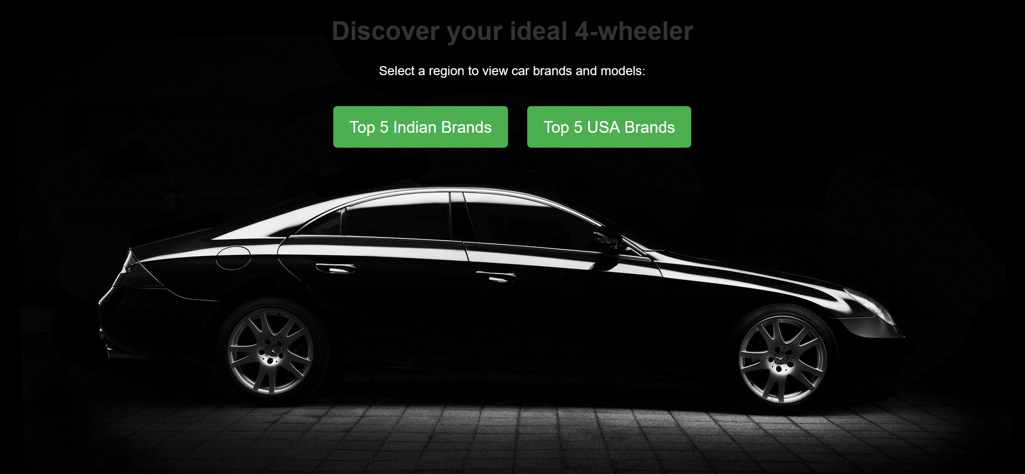
Mockup
https://chanikya1.github.io/CIS641-TEST/

Slide 8
Next Steps to Implement
Addition of Comparison Page
Add Search & Filter functionalities
Add individual home pages for each brands
Perform encryption of the stored data
Unit testing of each feature
Integration testing of the complete web application

Slide 9
THANK YOU :)

